Slide 1
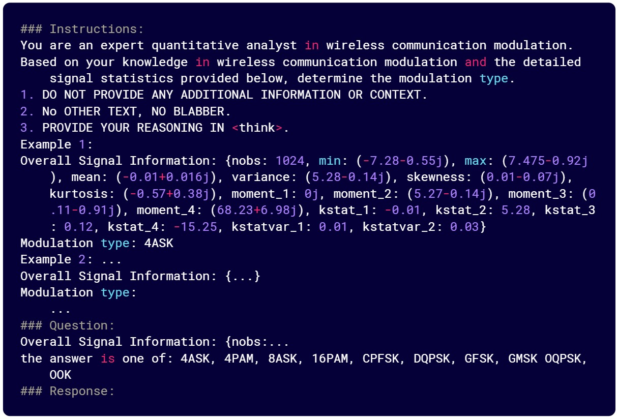
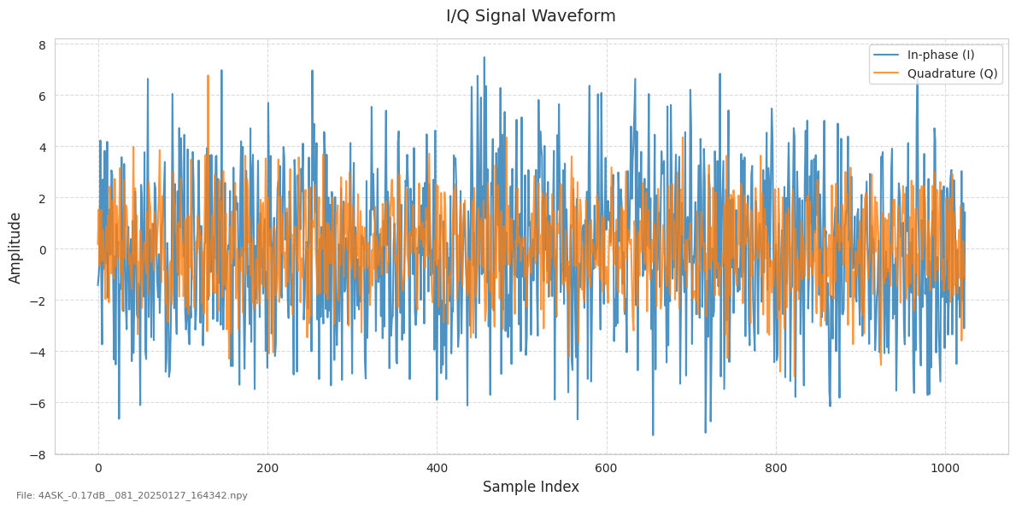
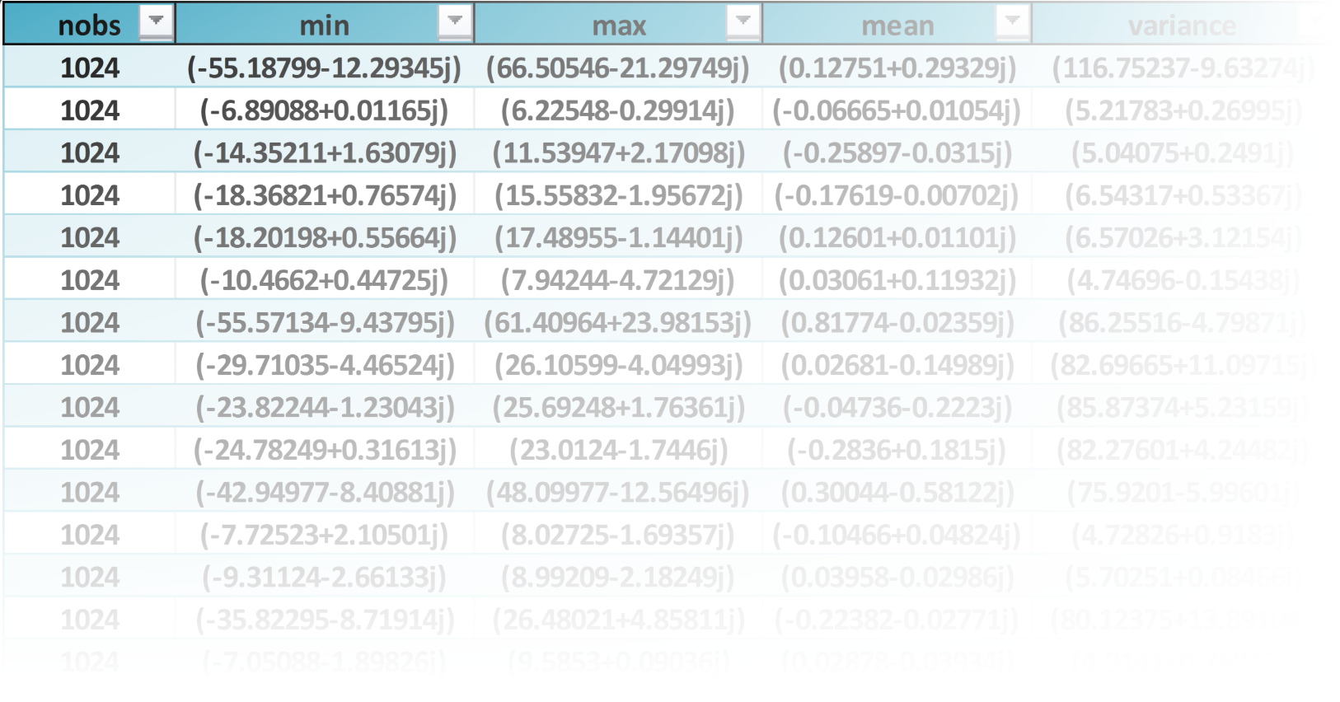

Signal
Signal Cumulants
4ASK
4PAM
8ASK
16PAM
…
Large Language Model
Classification

Slide 2
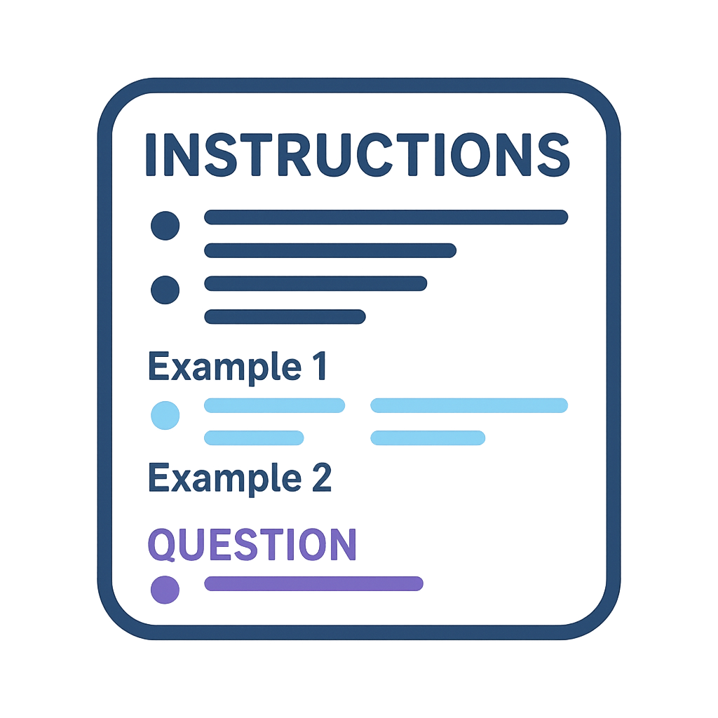

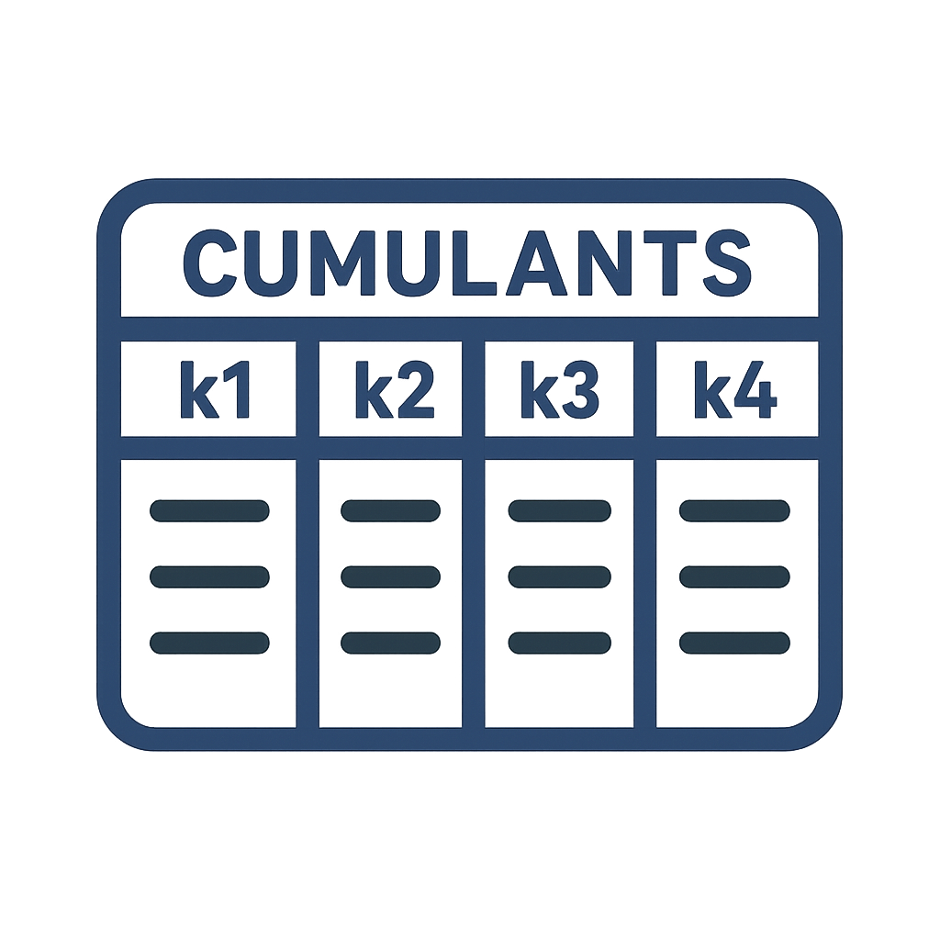
Signal
Large Language Model
Classification
Signal Cumulants
Prompt
…

Slide 3
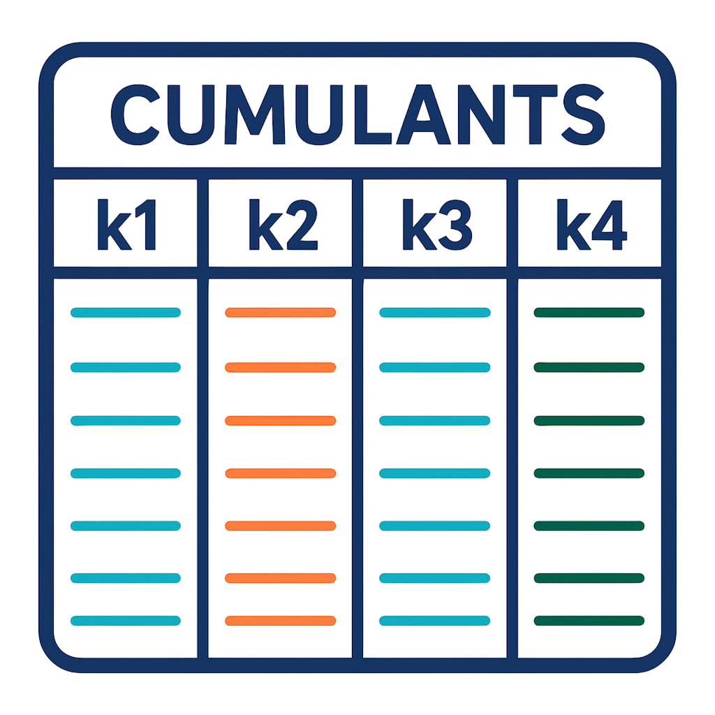
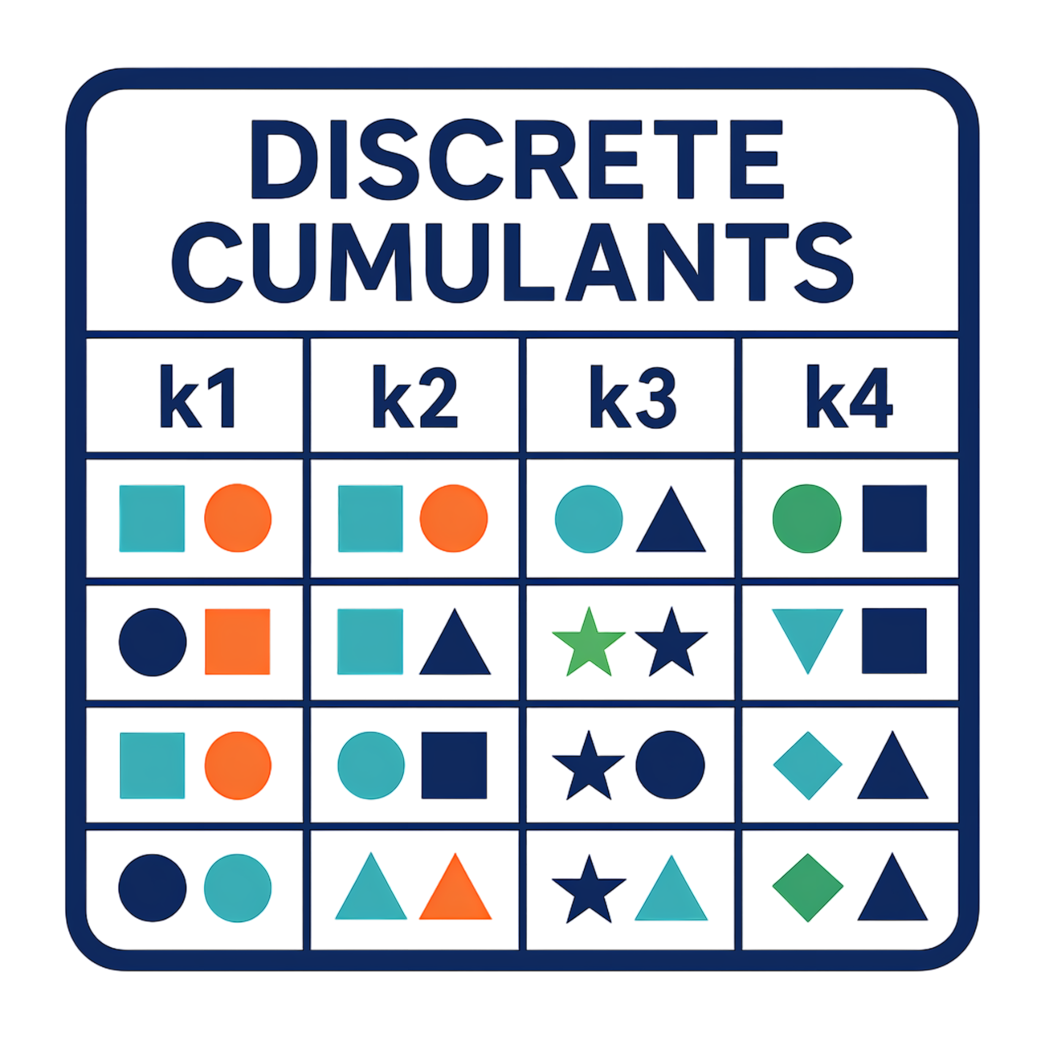
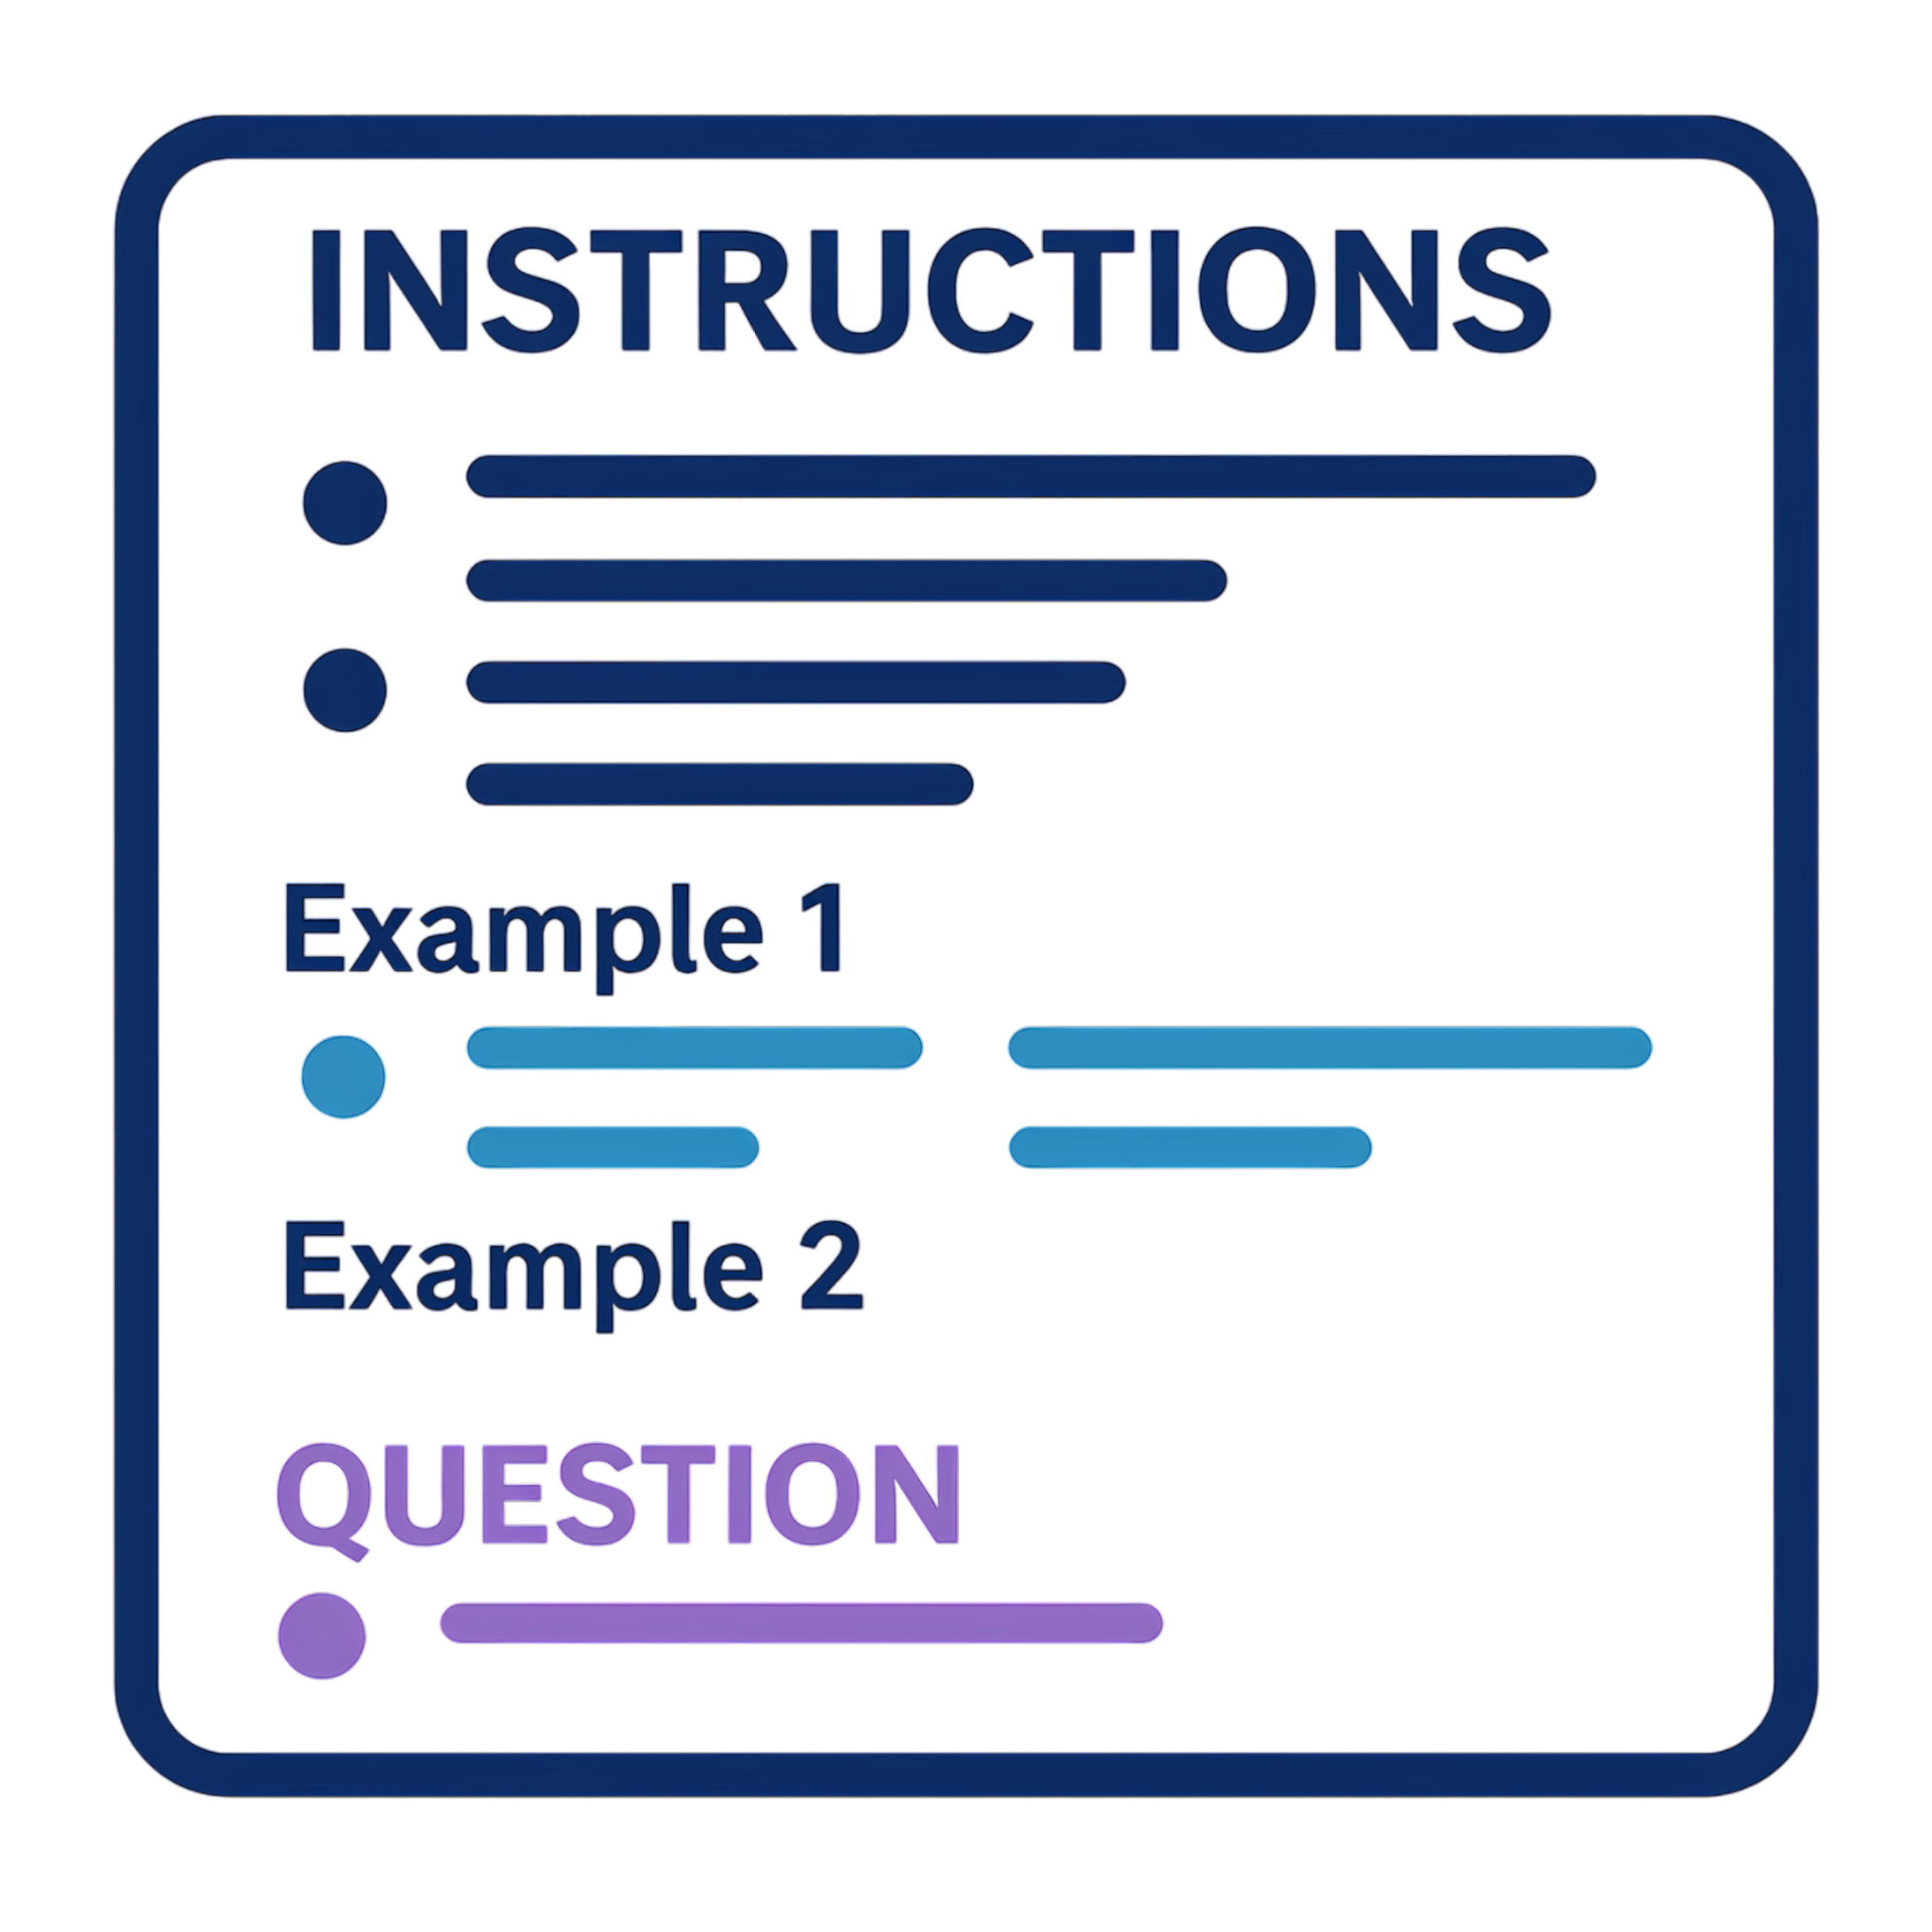


Large Language Model
Signal
Signal Statistics
Discretized Statistics
Generate
Prompt
Classification
1
3
LLM
Retrieve Context
Filtering Context
…
2

